Slide 1
Pushing the envelope…
New and innovative ways to leverage Open Source Toolkits for the ERMA portal
Aaron Racicot (Z-Pulley Inc)
Dane Springmeyer (DBSGeo)

Slide 2
Architecture

Slide 3
Current Architecture
USER
USER
User Interface
(Custom HTML/JS and Openlayers)
Internet
User Interface
Layer
Web Server
(Apache/mod_perl)
GIS
(Mapserver)
Custom Perl Module
Modeling/Analysis
Layer
SERVER
???
Data Layer
Database (PostgreSQL/PostGIS) & File Server (Linux - Fedora)

Slide 4
Architecture Direction
Consolidation of Languages
Migrate to Python where it makes sense
Integrate frameworks
GeoDjango – Authentication, REST Services, Admin
GeoExt – UI Layout, Cross Platform Support
Increase ease of deployment
Automate with install scripts
Reduce dependencies

Slide 5
Possible Future Architecture
USER
USER
User Interface
(GeoExt and Openlayers)
Internet
User Interface
Layer
Web Server
(Apache/mod_python)
GIS
(Mapserver/Mapnik)
Framework
(GeoDjango)
Modeling/Analysis
Layer
SERVER
Integration Framework
(Python)
Data Layer
Database (PostgreSQL/PostGIS) & File Server (Linux - Ubuntu)

Slide 6
Current Short List
Shortcuts for speed
Server/Connection speed
Faster map requests via Caching (TileCache)
Database optimization (indexing, normalization)
Avoid on-the-fly reprojection – Harmonize into common projection
Frameworks and Libraries for:
Security
Wrapping WMS/WFS services in authentication framework
Cross Platform Support
Get IE support enabled
UI Layout optimization
Increase map size
Online help
Increased print functionality

Slide 7
Current Long List
Batch uploads
Search and Query capability
Enhanced Reporting
Incorporate 3rd party datasets (IOOS etc), both WMS/WFS/WCS
Custom groups for categorizing users, AOI’s, visible datasets, etc.
Bookmarks for quickly allowing users to scale to a project scope in the interface

Slide 8
Speed

Slide 9
Tile Serving with TileCache
User Interface
(OpenLayers)
User Interface
(OpenLayers)
http://labs.metacarta.com/wms-c/tilecache.py/1.0.0/basic/5/32/23.png
http://labs.metacarta.com/wms-c/tilecache.py/1.0.0/basic/5/32/23.png
Internet
Internet
Web Server
(Apache)
Web Server
(Apache)
Cache Miss
Cache Hit
TileCache
TileCache
Disk Cache
GIS
(Mapserver/Mapnik)
GIS
(Mapserver/Mapnik)
Database
(PostgreSQL/PostGIS)
Database
(PostgreSQL/PostGIS)

Slide 11
Projections
User Interface
(OpenLayers)
User Interface
(OpenLayers)
http://labs.metacarta.com/wms-c/tilecache.py/1.0.0/basic/5/32/23.png
http://labs.metacarta.com/wms-c/tilecache.py/1.0.0/basic/5/32/23.png
Internet
Internet
Web Server
(Apache)
Web Server
(Apache)
GIS
(Mapserver/Mapnik)
GIS
(Mapserver/Mapnik)
Proj Mismatch
Proj Match
Database
(PostgreSQL/PostGIS)
Database
(PostgreSQL/PostGIS)
Proj4
Proj4

Slide 12
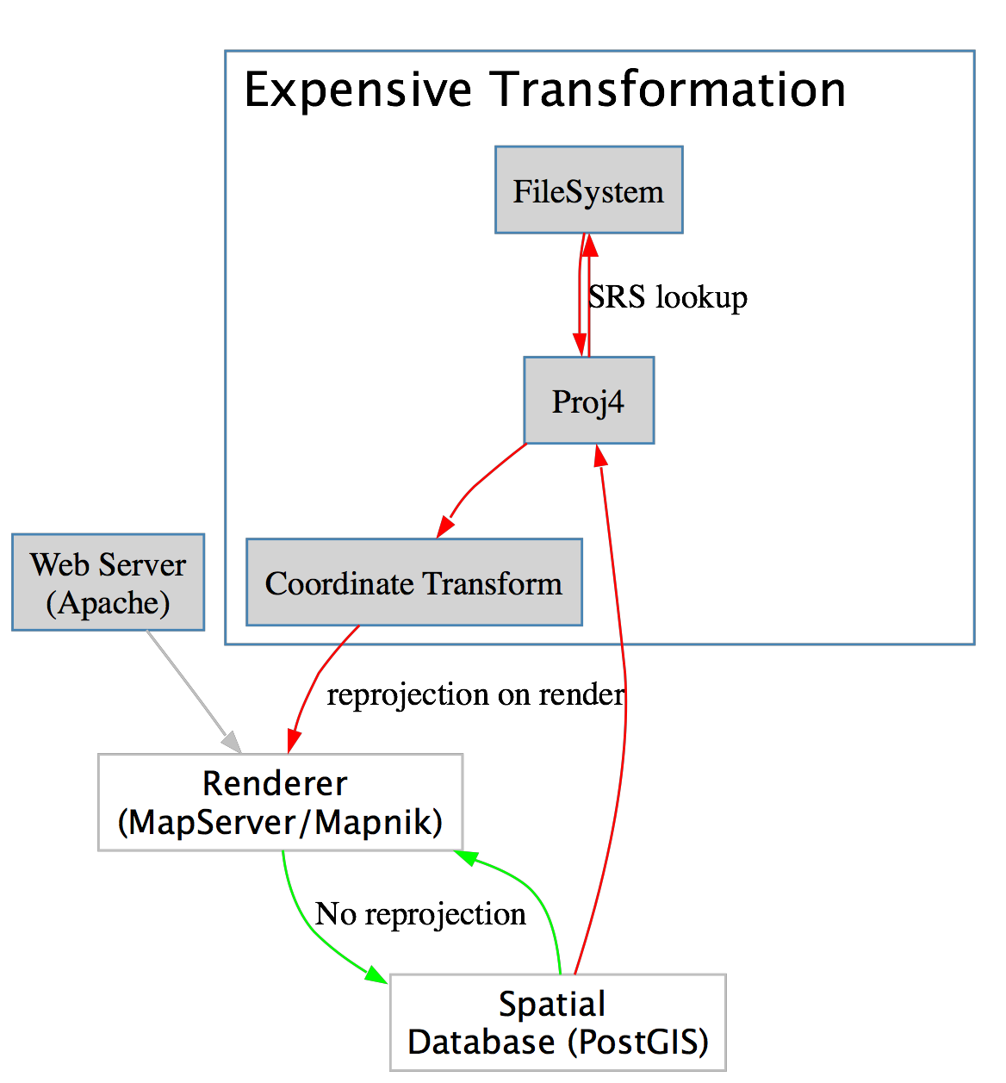

Slide 13
Frameworks

Slide 14
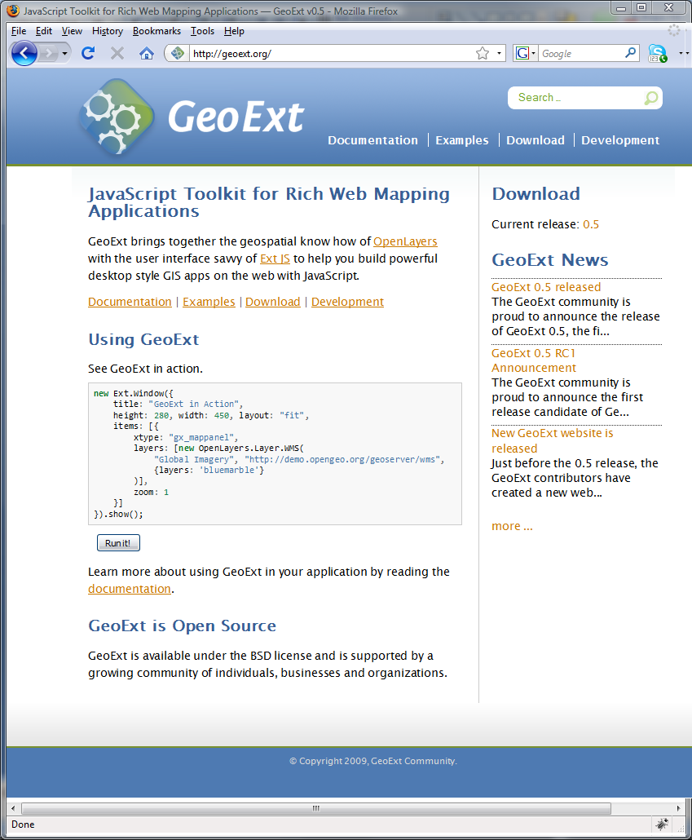
ExtJS GeoExt

Slide 15
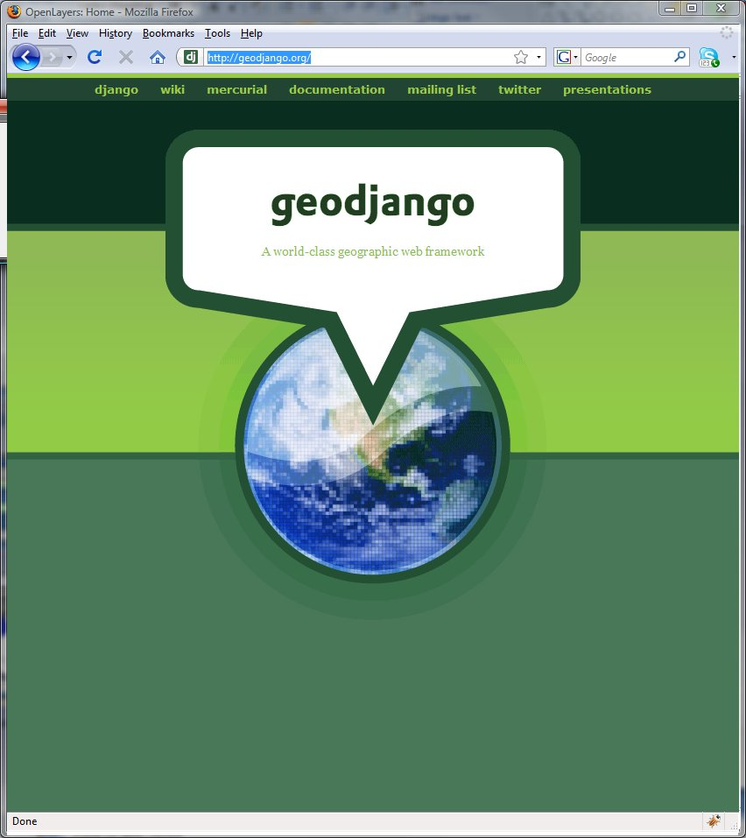
Django GeoDjango

Slide 16
Rendering

Slide 17
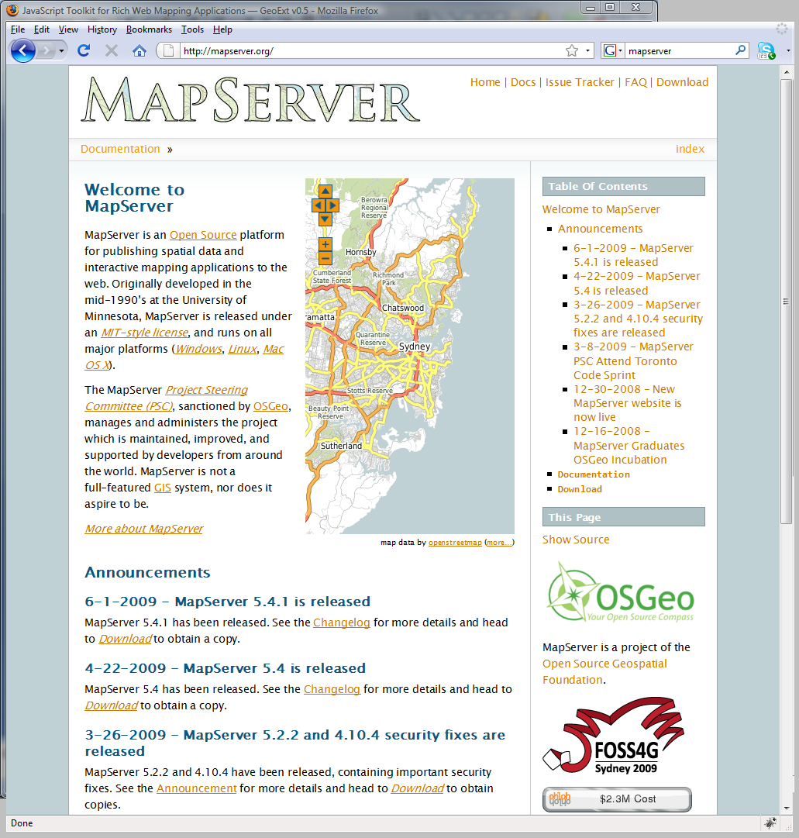
Mapserver Mapnik

