Slide 1
Web-Based Tool and Why
Cross Platform Support
Multi-User
No special software to install… just a browser
Offload real work to server
No worrying about versions of data/software
Integrated GIS capabilities
Potential for wide range of users…
public<->modelers
Utilizing Open Source Software
Reduce Cost
Increase transportability

Slide 2
Common Workflows Fit Well With OS GIS Tools
Data Collection
Model Integration
Web-Based DST’s
????
(Flexibility)
Reduced Expense for Tight Budgets
Software Expense
Contracting/ Development
Deployment and Hosting
????
(Flexibility)
Standards Based – Transparent Development
Standards Focused
Open Development
Community Building
????
(Flexibility)

Slide 3
Explaining the Stack
OS GIS Web Apps
Mapserver, OpenLayers, etc.
OS GIS Desktop Apps
QGIS, GRASS, etc.
OS GIS Base Tools
(GDAL, OGR, PostGIS, etc.)
OS Base Tools
(Apache, Compilers, etc.)
OS Core
(Linux)
Notes:
I added bullets to some boxes—please check to ensure correctness.

Slide 4
What We Have Done
Users Modify Parameters
TISEC DSS
Request Sent to Server
Server Processes Request
Web
Results Populated In Database
Results are spatially joined
Maps and Data are Returned
Users Visualize Results

Slide 5
Simplified IDSS Architecture
USER
USER
User Interface
(ExtJS and Open Layers)
Internet
User Interface
Layer
Web Server (Apache)
Map Server
Framework (Django)
Process
Layer
Tidal power calculations
Module
GIS Mapping & query tools (Mapserver)
Data Layer
Database (PostGIS) & File Server (Linux)

Slide 6
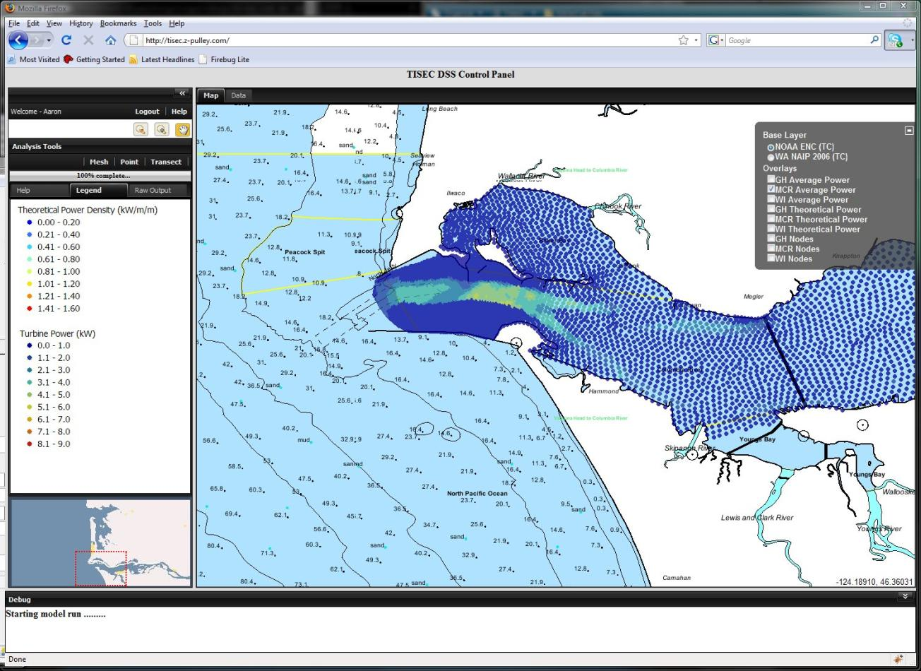

Slide 7
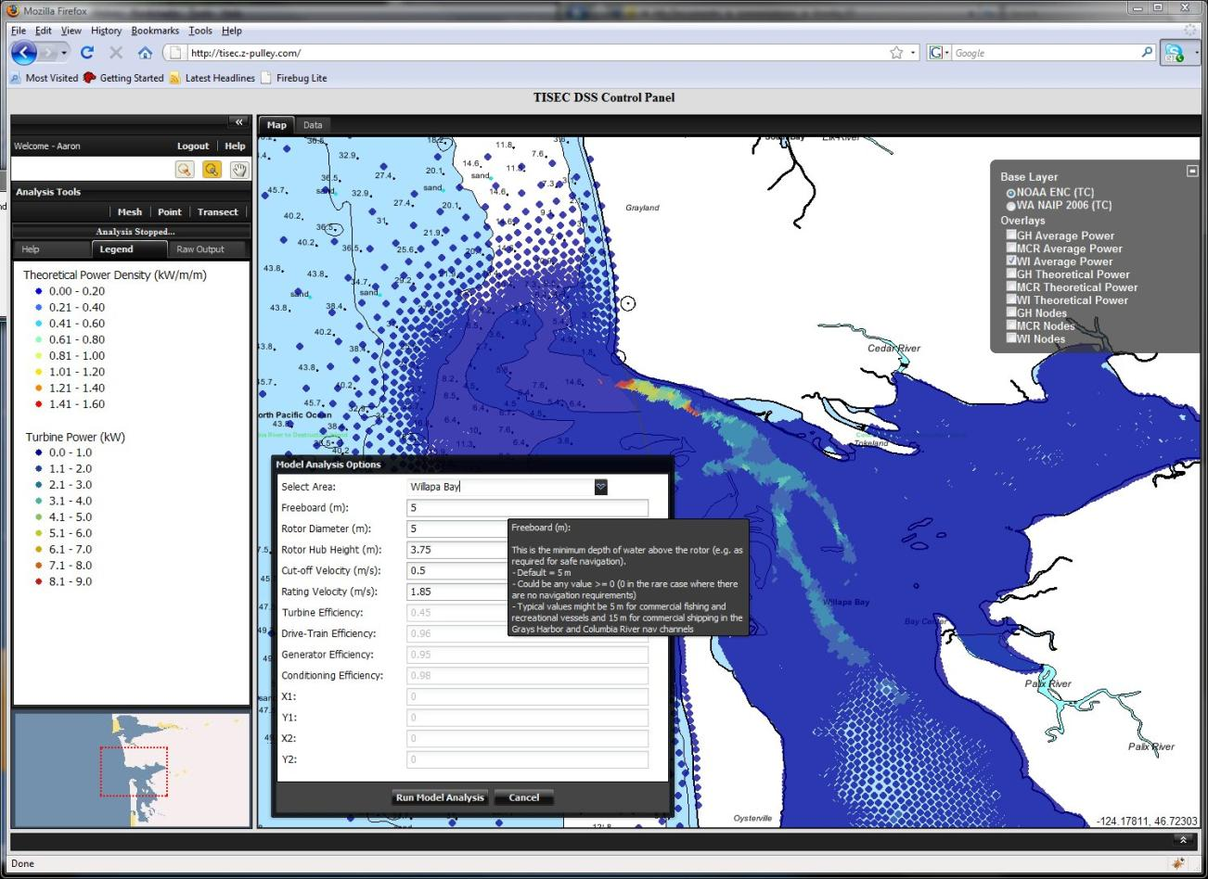

Slide 8
