Slide 1
QGIS Plugins
Creating custom spatial functions within the QGIS application framework using Python

Slide 2
Plugin?
Extends the functionality of QGIS
Written in C++ or Python
QGIS provides access to UI and Core
Models the QT structure
QGIS widgets are just QT widgets
PyQt is cool… almost fun!

Slide 3
Why Open Source?
Cost
Freedom
Community
Get Good Karma
Opportunity to innovate
Very Fast Development Cycle
Very Low Barrier To Dev Community Entry

Slide 4
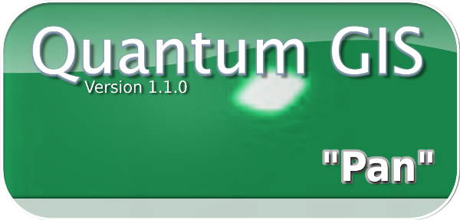
PyQGIS
PyQT

Slide 5
Why QT and PyQt?
QT is Open Source and well supported (Nokia)
QT is cross platform with support for multiple compilers (msvc, ming)
QGIS was developed on top of QT
PyQt is a reference implementation of Python bindings to C++ applications using SIP
QGIS has been extended to provide PyQGIS

Slide 7
# PyQt4 includes for python bindings to QT
from PyQt4.QtCore import *
from PyQt4.QtGui import *
# QGIS bindings for mapping functions
from qgis.core import *
from qgis.gui import *

Slide 8
That wasn’t so hard…

Slide 9
Python Inside QGIS…

Slide 10
Installing Plugins

Slide 11
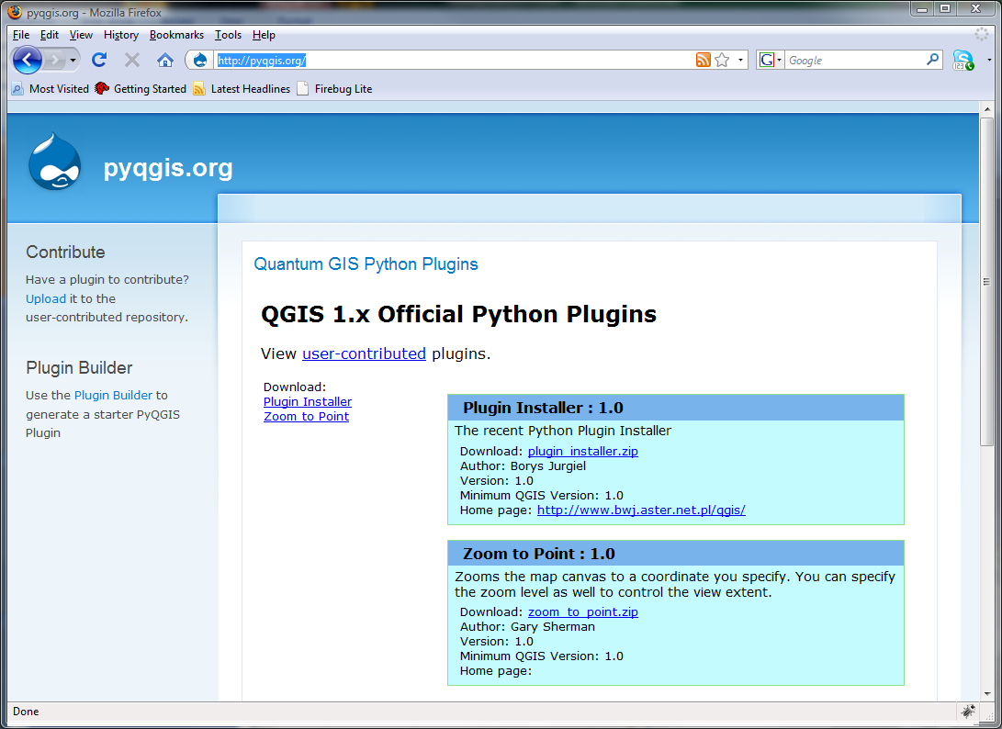
Repo’s

Slide 12
Repo’s… just some XML

Slide 13
Plugin Building
Create from scratch… don’t recommend
Copy existing… great place to start
Plugin Builder… ah, that’s to easy

Slide 14
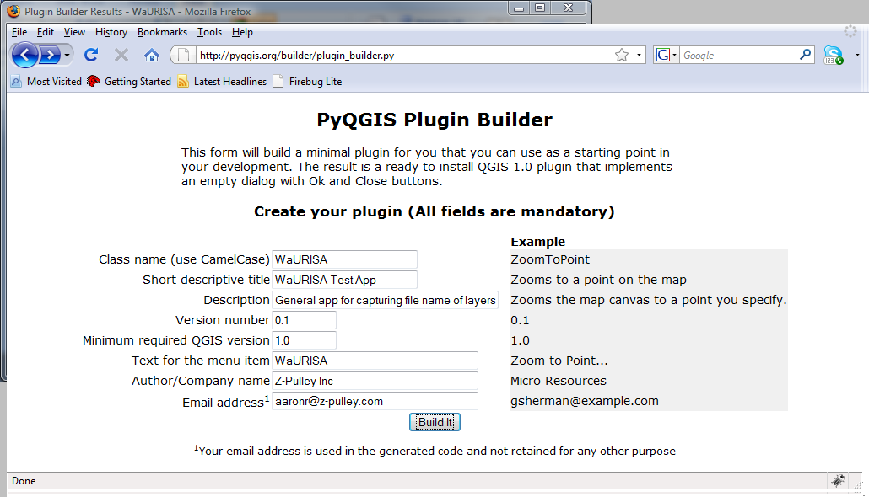
Plugin Builder
http://pyqgis.org/builder/plugin_builder.py

Slide 15
Where do they live?
%working_dir%\.qgis\python\plugins
SECRET: That is where the plugin installer puts them!

Slide 16
Designer
Let’s you add GUI elements via graphical interface
Focuses on Widgets and Layouts
Generates UI files
Natively consumed in QT
Must be compiled in PyQT
http://www.riverbankcomputing.co.uk/software/pyqt/download
OSGEO4W does not contain designer… download separately

Slide 17
Lets build one…
Run through the Plugin Builder
Unzip into .qgis\python\plugins
Test
Open .ui file in Designer and modify
Compile .ui -> .py
Hook into a SIGNAL from the UI in plugin

Slide 18
QtCore.QObject.connect(iface.mapCanvas,
QtCore.SIGNAL("xyCoordinates(QgsPoint&)"),
self.updateCoords)
Def updateCoords(self,p):
capture = QtCore.QString(str(p.x()) + " , " + str(p.y()))
self.lineEdit.setText(capture)

Slide 19
Cool List
fTools
ManageR
PostGIS Manager
WaURISA Test Plugin ☺

Slide 20
References
PyQGIS
Bindings - http://wiki.qgis.org/qgiswiki/PythonBindings
API - http://doc.qgis.org/head/classes.html
QT API - http://doc.trolltech.com/4.5/index.html
PyQT Docs - http://www.riverbankcomputing.co.uk/static/Docs/PyQt4/pyqt4ref.html
SIP Docs - http://www.riverbankcomputing.co.uk/static/Docs/sip4/sipref.html
Official Plugin Repo - http://pyqgis.org/
Plugin Builder - http://pyqgis.org/builder/plugin_builder.py

Slide 21
Help
#qgis on freenode IRC
http://www.qgis.org/community/mailing-lists.html
http://www.qgis.org/index.php
http://blog.qgis.org/
http://forum.qgis.org/
https://trac.osgeo.org/qgis/

