Slide 1
QGIS Workflows
QGIS and Python… like peanut butter and jelly

Slide 2
Peanut Butter (QGIS)
It’s Smooth (all the basics of GIS)
It’s Organic (by the people for the people)
Grow your own (it is encouraged!)

Slide 3
Jelly (Python)
Everything tastes better with it
Holds your sandwich together

Slide 4
Goals
Basic GIS (viewing and interacting with data)
Data Sources, Speed, and Projects
Editing (creation and editing of data)
Creating and correcting data layers
Leveraging (utilizing GRASS within QGIS)
Data path => QGIS -> GRASS -> QGIS
Extending (smearing Jelly on your sandwich)
Python plugins… fTools, RefMap, Plugin Builder
Embedding (new Jelly apps with QGIS inside)
Custom App Deployment… OpenOceanMap, QGISLite

Slide 5
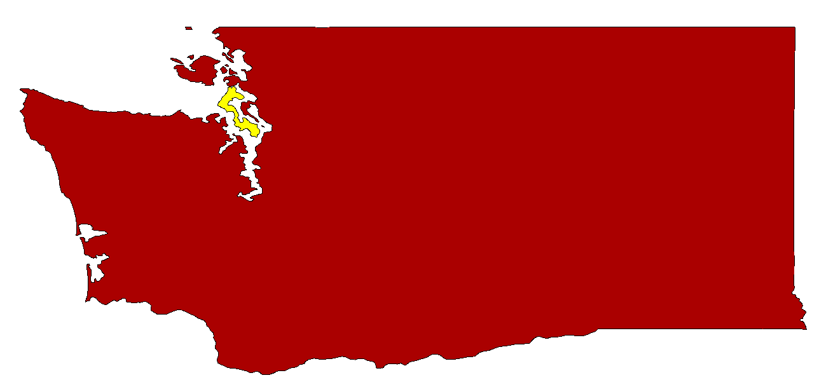
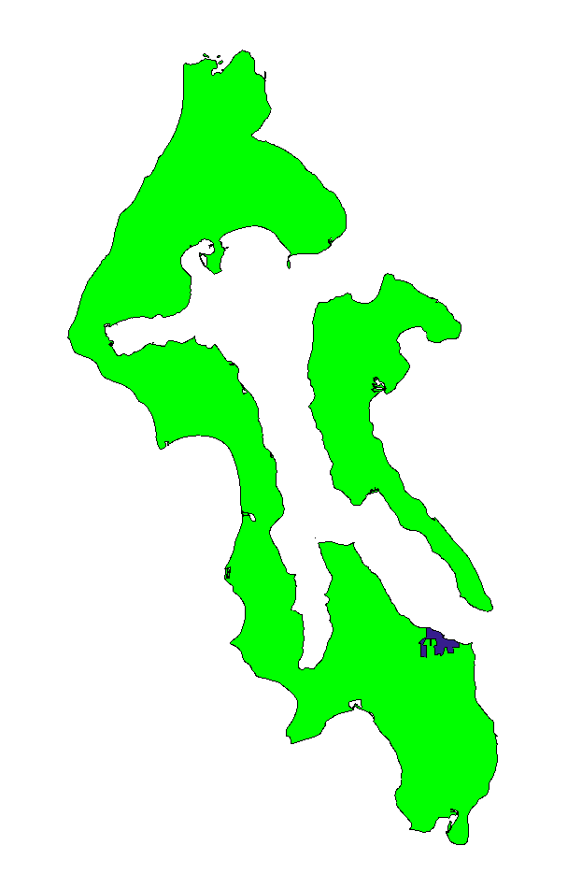
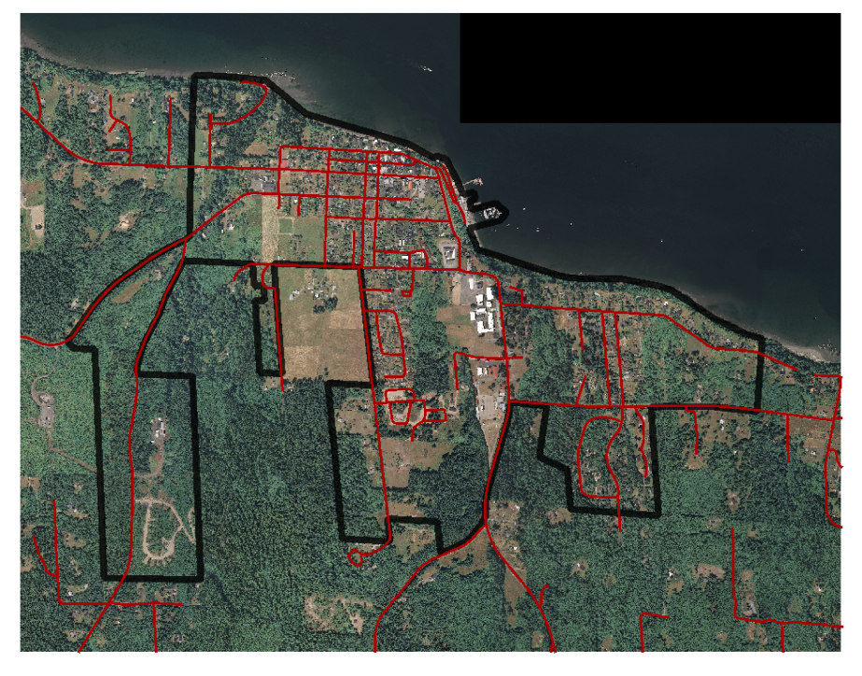
Demo Dataset
Langley Washington
http://www.reprojected.com/presentations/Presentations/waurisa_2009/waurisa_os_workshop_6inch.tar.gz
http://www.reprojected.com/presentations/Presentations/waurisa_2009/waurisa_os_workshop_basedata.tar.gz

Slide 6
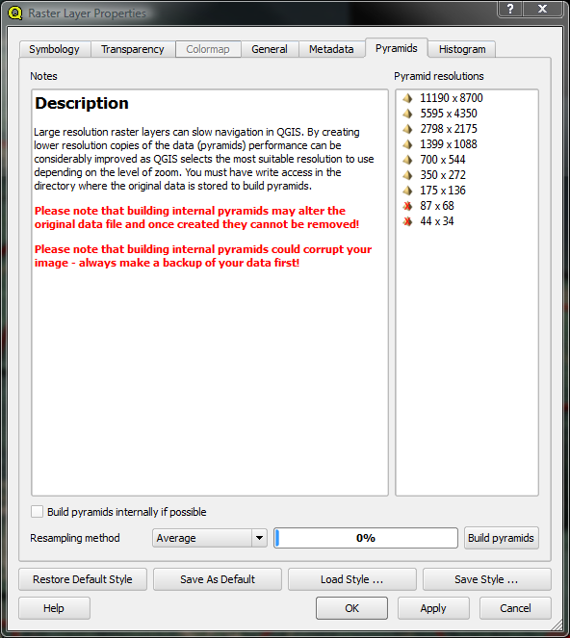
The Basics
Open a Raster
langley_2007_ortho_2285.tif
Over 1 gig, but with overviews (Pyramids) for speed
gdaladdo langley_2007_ortho_2285.tif 2 4 8 16 32 64 128
Right-Click layer in legend, Properties, Pyramids Tab

Slide 7
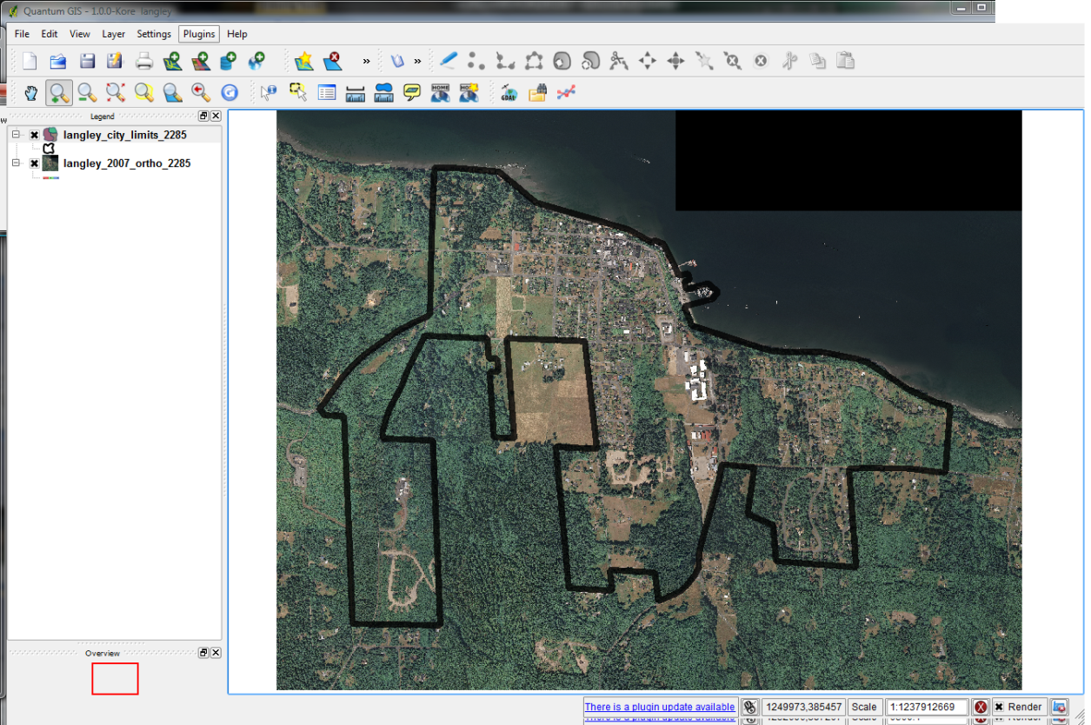
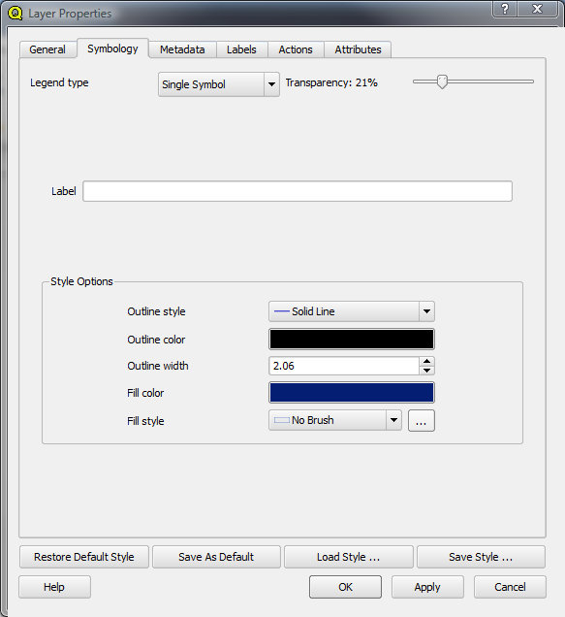
Open a Vector
langley_city_limits_2285.shp
Need to style via the properties dialog
Right-Click layer in legend, Properties, Symbology Tab

Slide 8
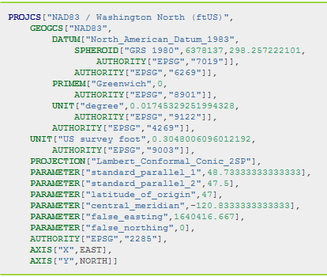
Projections
Project Projection vs. Layer Projection
Vector “On the fly” Projection
In this demo we are using EPSG:2285
Washington State Plane North (ft)

Slide 9
Play with the data…
Zoom, Pan, Identify
Open Attribute Tables
Select
Click on map
Query Builder in attribute table
Label
Label tab in Properties Dialog
Style
Modify and Save

Slide 10
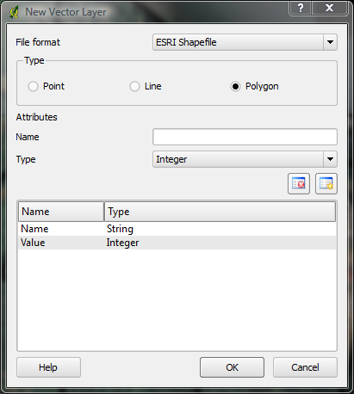
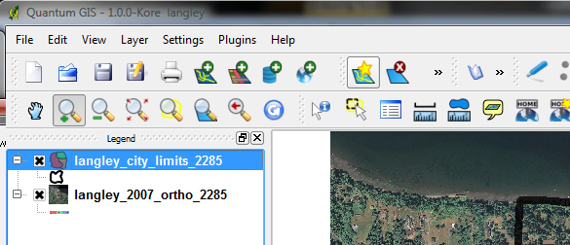
Editing
Create New Dataset
Give at least one attribute
Select name of new shapefile
Toggle editing
Draw your shapes!

Slide 11
Editing
Modify Dataset
Select dataset in legend
Toggle editing
Modify existing dataset

Slide 12
Save… Save Often

Slide 13
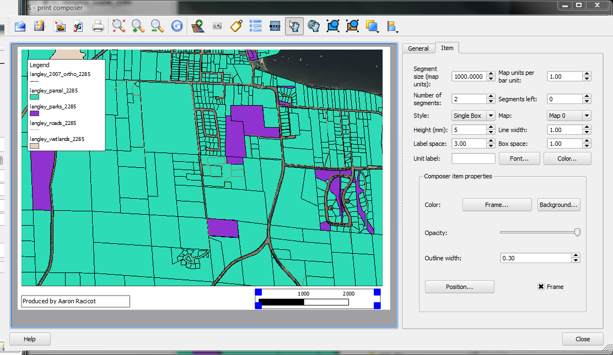
Printing

Slide 14
GRASS
The crunch in the Peanut Butter…
Enable via Plugin Manager…

Slide 15
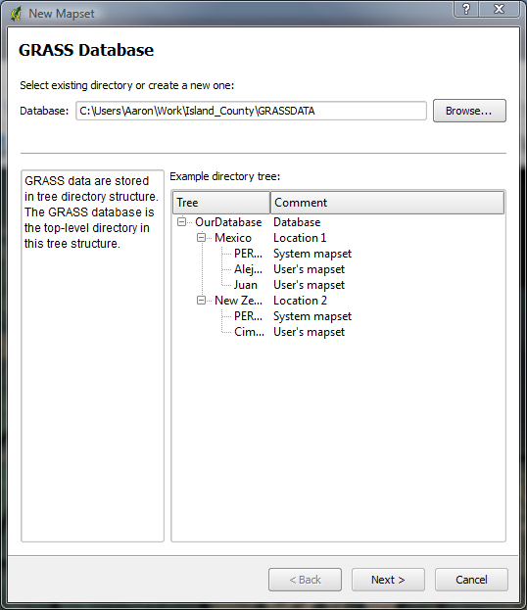
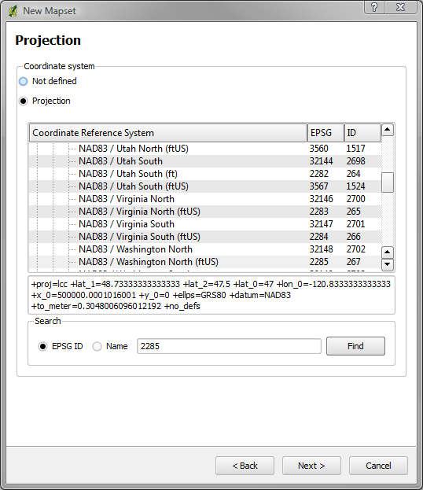

Slide 16
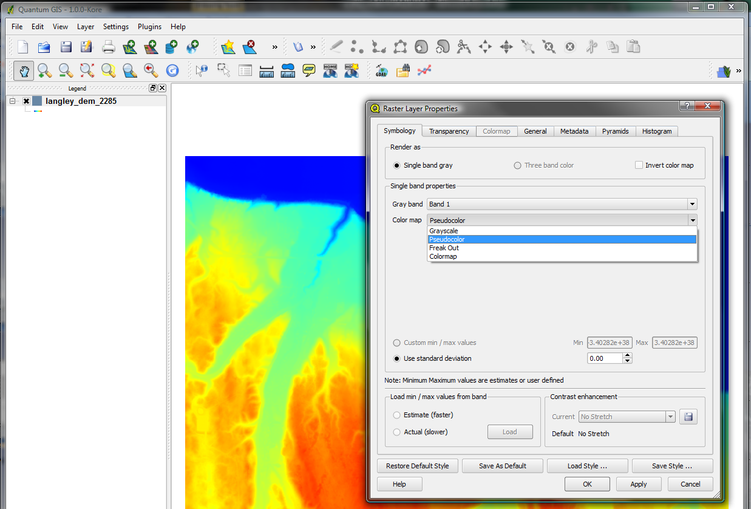
Contours and shaded relief from DEM
Load DEM (tif) into QGIS
Style the DEM to be pseudocolor
Load the DEM into GRASS via GRASS toolbar
NOTE: Layer must be
loaded into QGIS before
it can be loaded into
the GRASS plugin

Slide 17
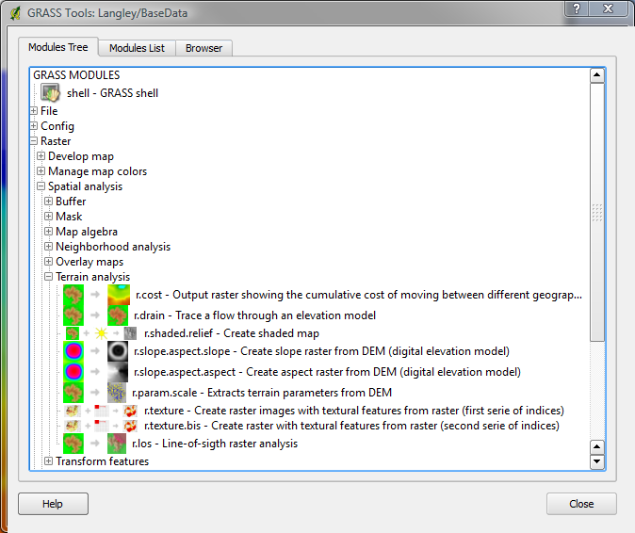
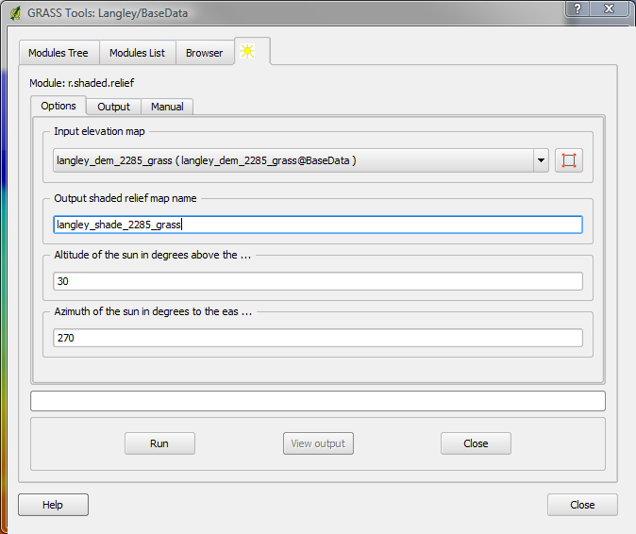
Shaded relief
Open GRASS Toolbox
Raster->Spatial Analysis->Terrain Analysis
r.shaded.relief

Slide 18
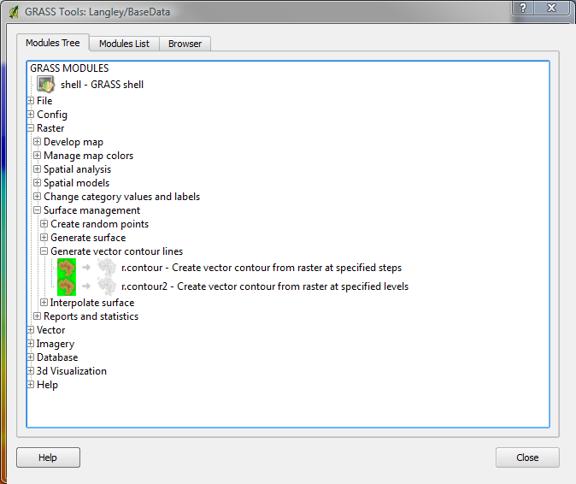
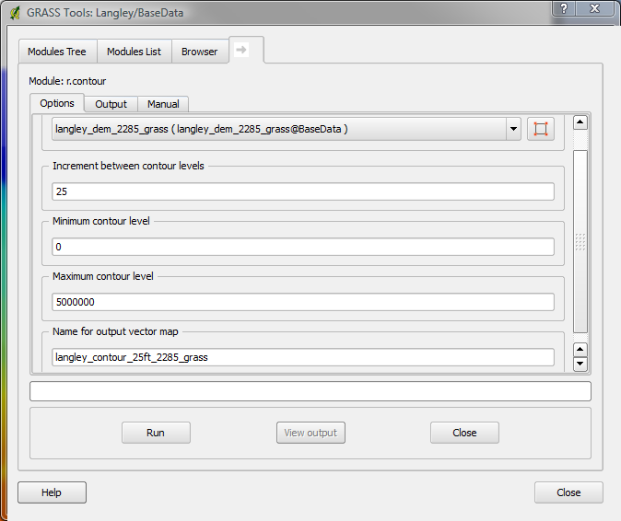
Contours
Open GRASS Toolbox
Raster->Surface Management->Generate vector contour lines
r.contour

Slide 19
Saving from GRASS
Vectors
Right click in legend and “Save as shapefile…”
GRASS toolbox
File->Export->Export Vector->v.out.ogr
Rasters
GRASS toolbox
File->Export->Export Raster->r.out.gdal.gtiff

Slide 20
Extending
Slapping some Jelly on that dry sandwich…
fTools Python Plugin
Carson Farmer

Slide 21
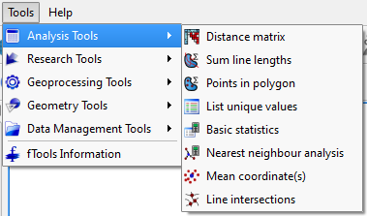
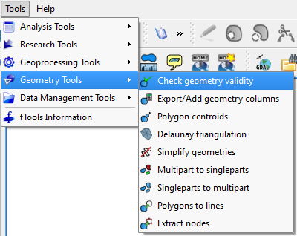
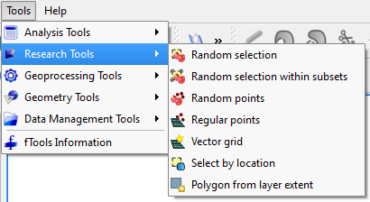
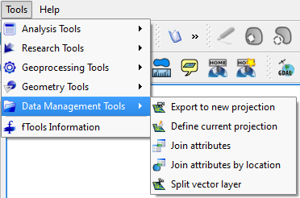
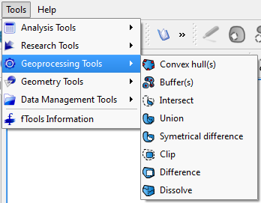
WOW

Slide 22
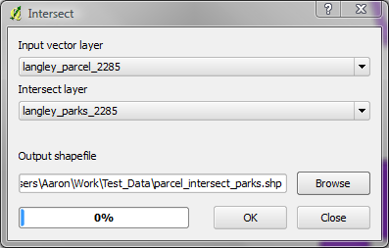
Intersect
“Get all parcels that intersect a park”
Tools->Geoprocessing Tools->Intersect

Slide 23
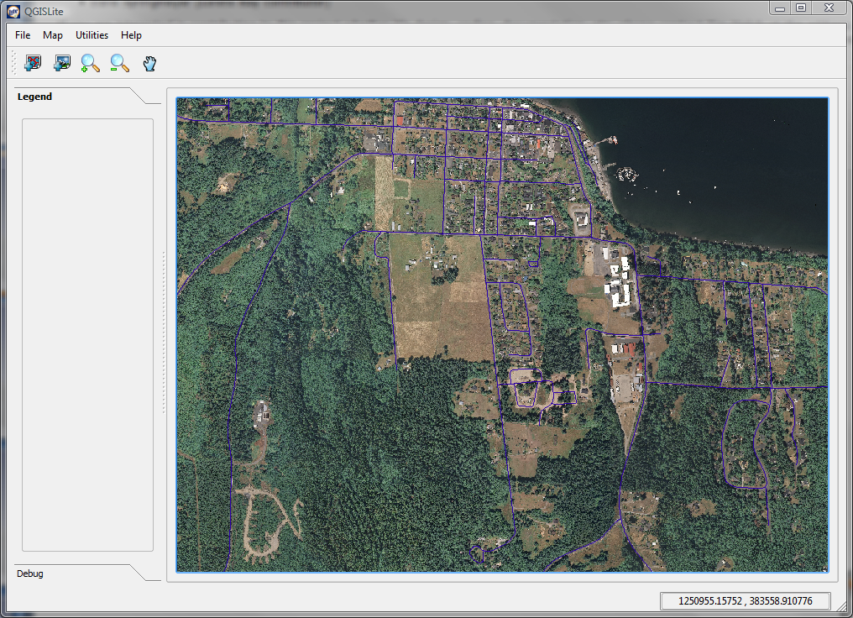
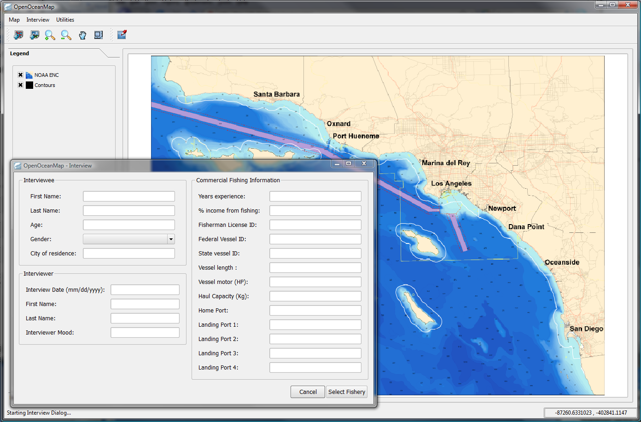
Embedding
Jelly on the outside… Peanut Butter on the inside…
OpenOceanMap
QGISLite

Slide 24
Other Formats
Great support for PostGIS
GDAL Plugins supported (.sid, .ecw, etc.)
VRT’s are your friend

Slide 25
Things we are still searching for…
Great print production
New work on composer
Integration with Mapnik
More spatial functions in Core or Python… less reliance on GRASS
Raster “on the fly” projection
Better labeling
Relative paths in project files
Many many many more …

Slide 26
References
PyQGIS
Bindings - http://wiki.qgis.org/qgiswiki/PythonBindings
API - http://doc.qgis.org/head/classes.html
QT API - http://doc.trolltech.com/4.5/index.html
PyQT Docs - http://www.riverbankcomputing.co.uk/static/Docs/PyQt4/pyqt4ref.html
SIP Docs - http://www.riverbankcomputing.co.uk/static/Docs/sip4/sipref.html
Official Plugin Repo - http://pyqgis.org/
Plugin Builder - http://pyqgis.org/builder/plugin_builder.py

Slide 27
Help
#qgis on freenode IRC
http://www.qgis.org/community/mailing-lists.html
http://www.qgis.org/index.php
http://blog.qgis.org/
http://forum.qgis.org/
https://trac.osgeo.org/qgis/

