Slide 1
www.haiticrisismap.org
One perspective on changes in crisis response… happening today
Aaron Racicot (Z-Pulley Inc)

Slide 2
If your technology can help a consumer find a great $4 latte, that’s good for your business.
If it can also help a child find clean water near their village, that’s good for the world.
Andrew Turner

Slide 3
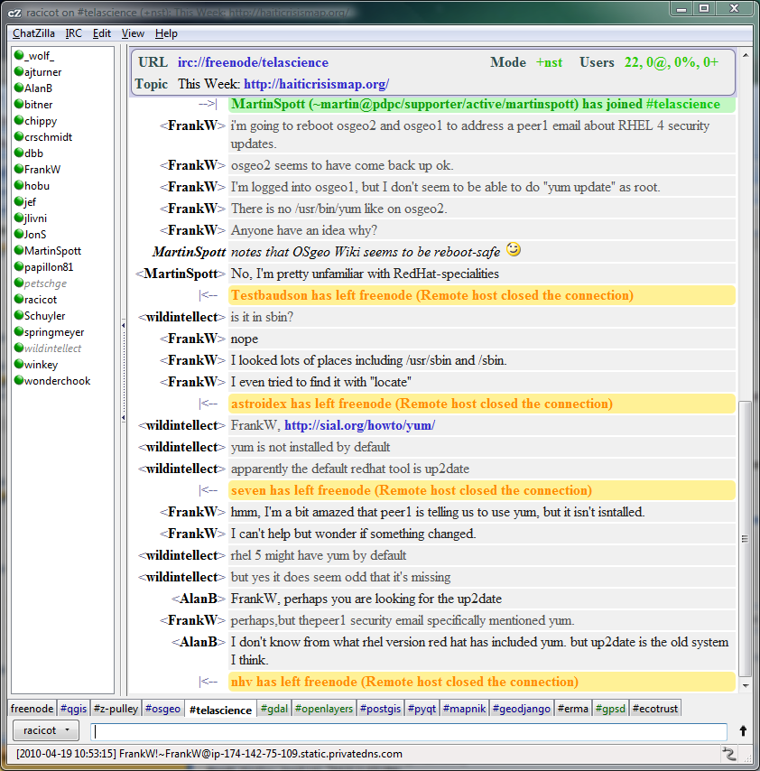
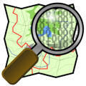
Initial Crisis Notification/Organization (My Experience)
IRC

Slide 4
Initial Data Processing
High Res Imagery
Satellite Imagery
First 2 weeks > 4+ TB of processed Imagery

Slide 5
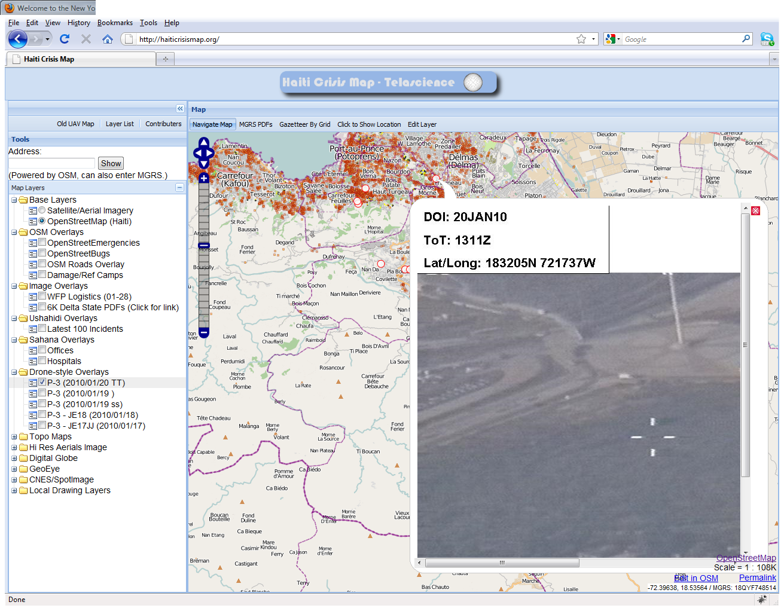
Initial Data Processing

Slide 6
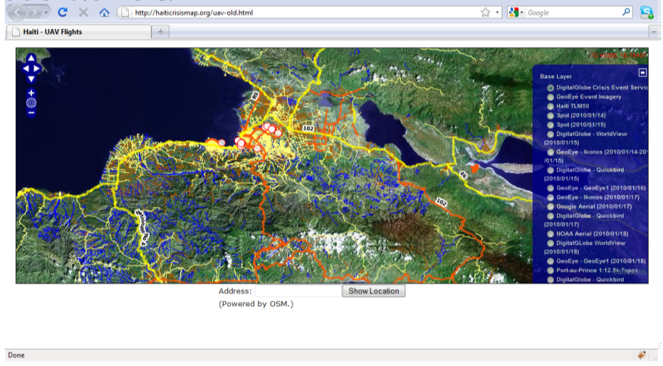
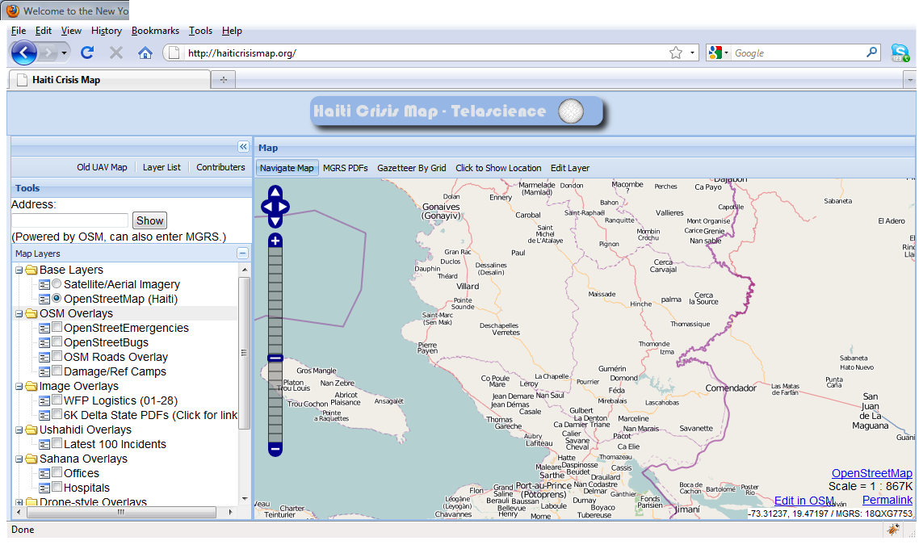
Flood of Requests Scaling

Slide 7
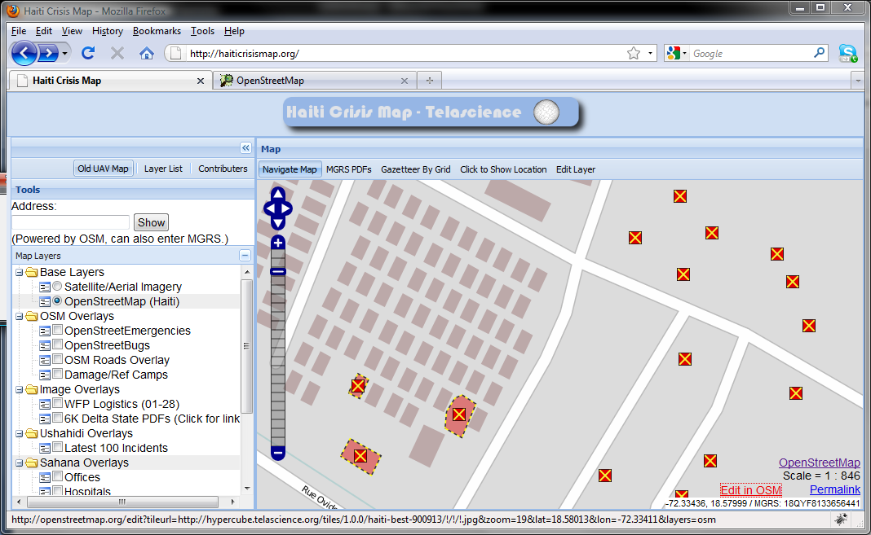
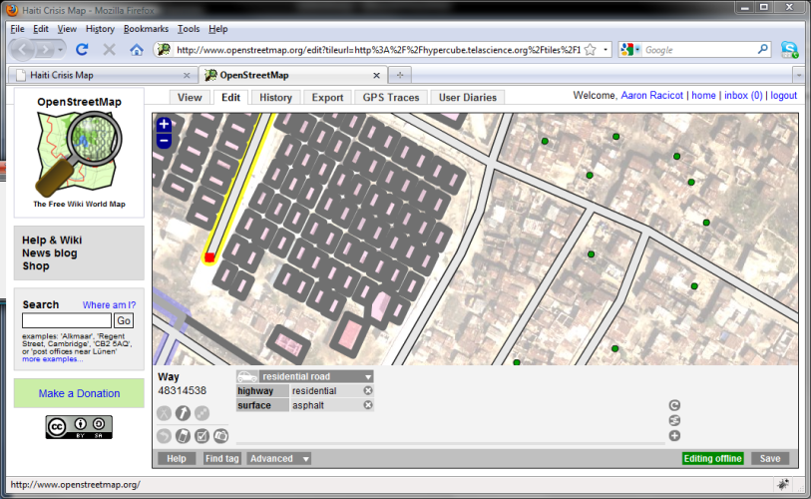
Flood of Requests Scaling

Slide 8
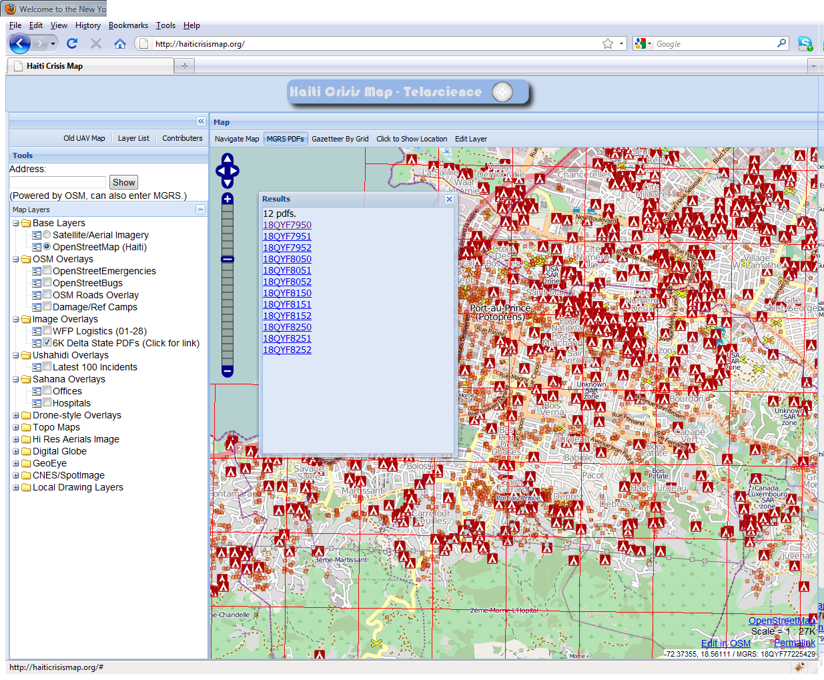
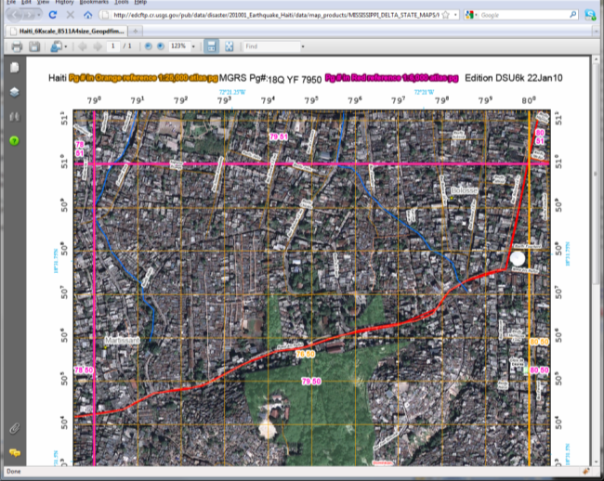
Integration of Custom Tools

Slide 9
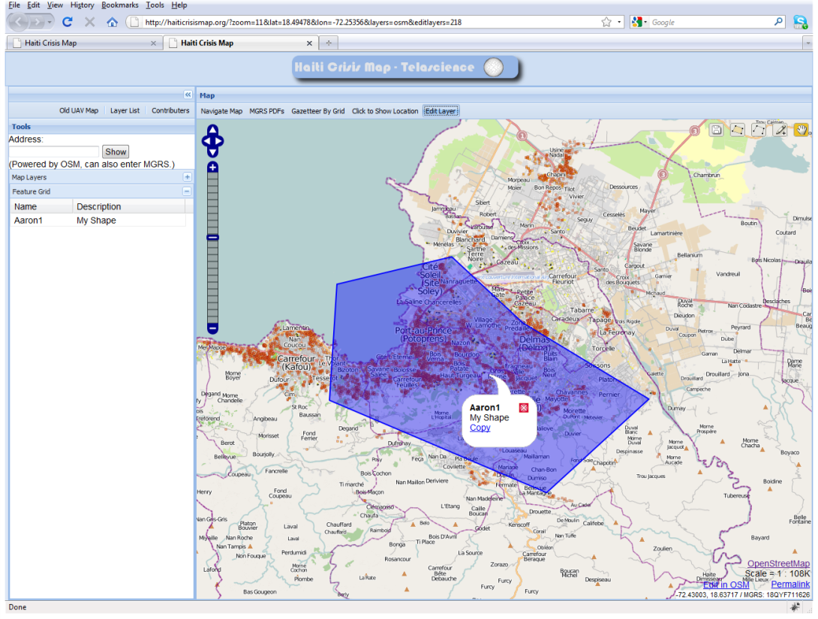
Integration of Custom Tools

Slide 10
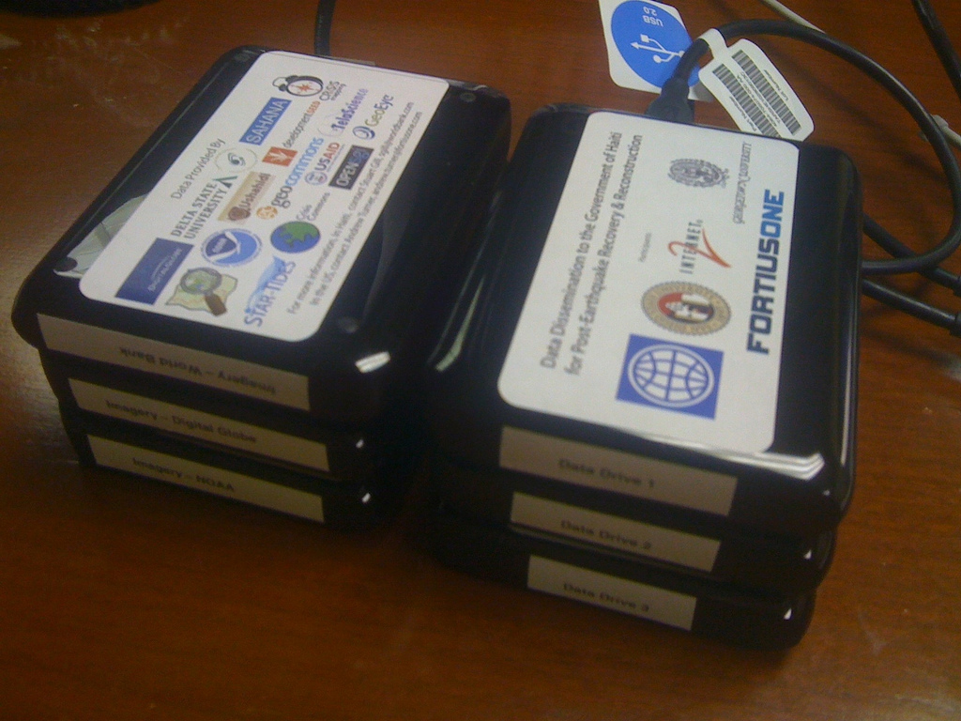
Stand Alone Packaging
Andrew Turner

Slide 11
Lessons Learned For Next Response
Dedicated Community
Open Source Tools
Open Data
Speed is critical
Typical turnaround for new data < 36 hrs
Providing technology to communities on the ground helping is key
Integration with OSM
Delta State PDF viewer
Flexibility of tools makes all the difference
Open Source Tools are like ingredients to any recipe you want to make
Production/consumption of standardized services (like WMS/GeoRSS/etc.)

Slide 12
Signs of progress…
Schuyler Erle

Slide 13
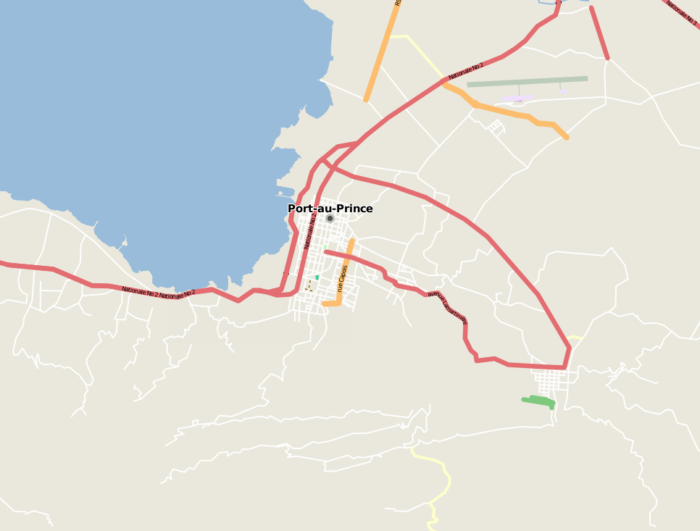
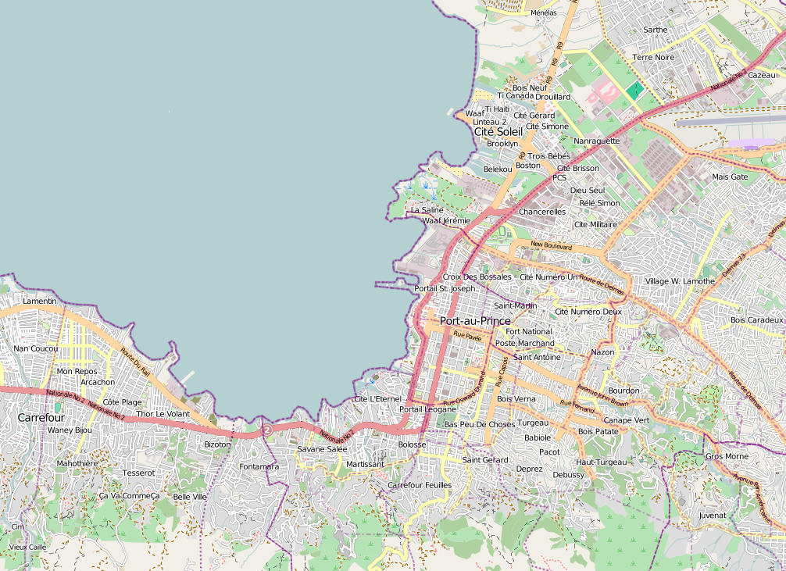
http://vimeo.com/9182869

Slide 14
Code and Data

Slide 15
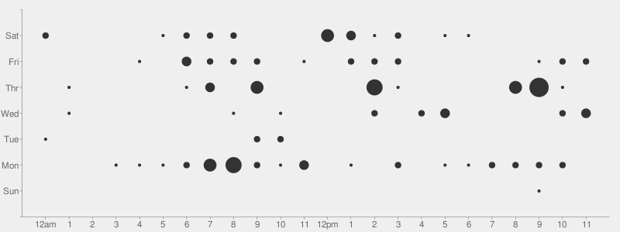
CODE
http://github.com/crschmidt/haitibrowser

Slide 16
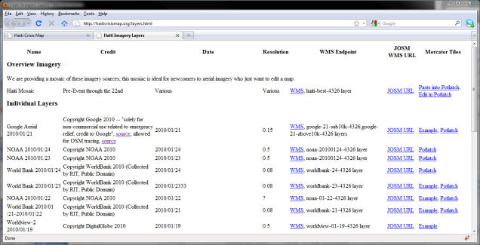
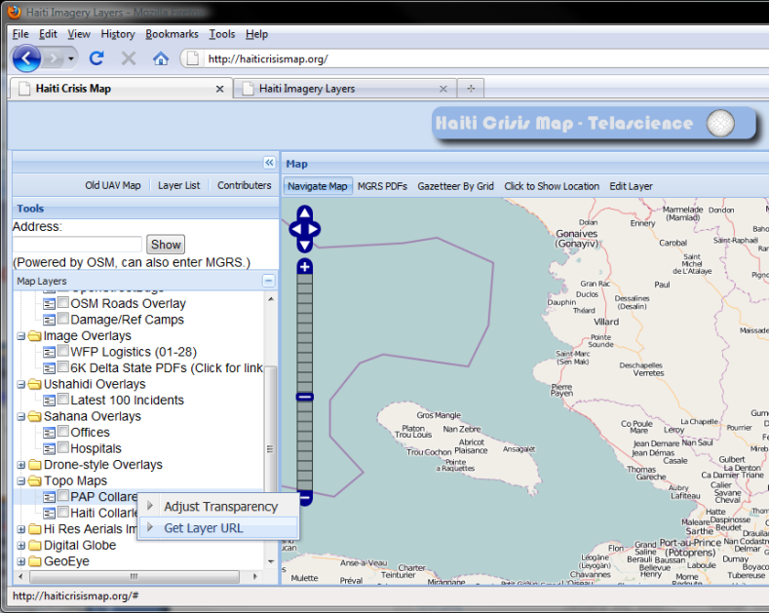
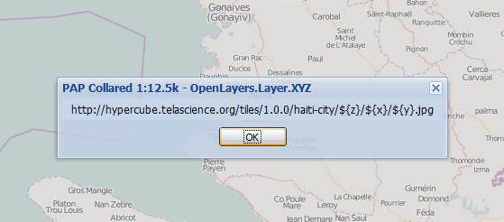
Data

Slide 17
In summary, the community is making a difference. The tools we develop in WhereCamp, IRC, open-source communities, and from companies are changing the capabilities of crisis response and development.
Andrew Turner

Slide 18
UI

Slide 19
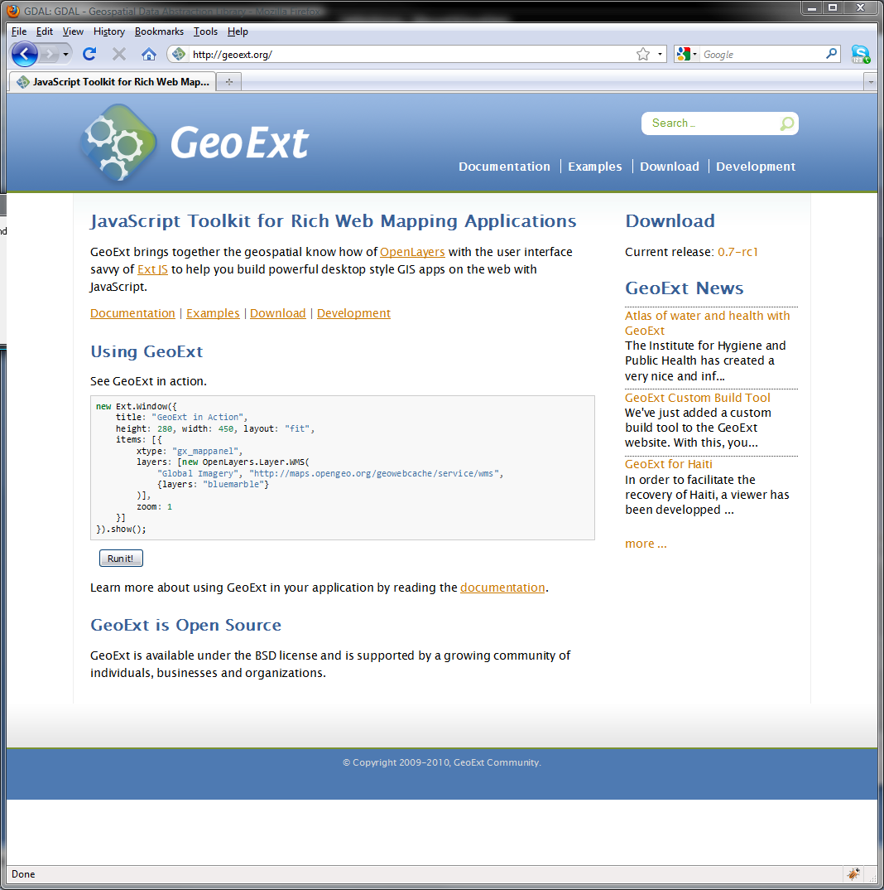
ExtJS GeoExt

Slide 20
Rendering

Slide 21
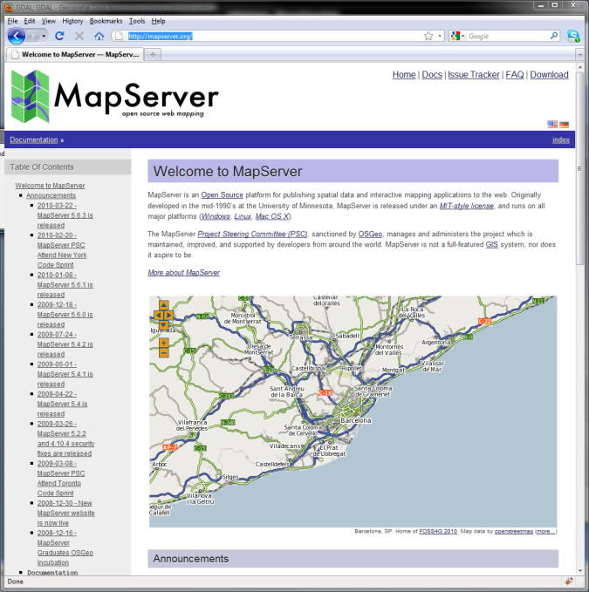
Mapserver Mapnik

Slide 22
Processing

Slide 23
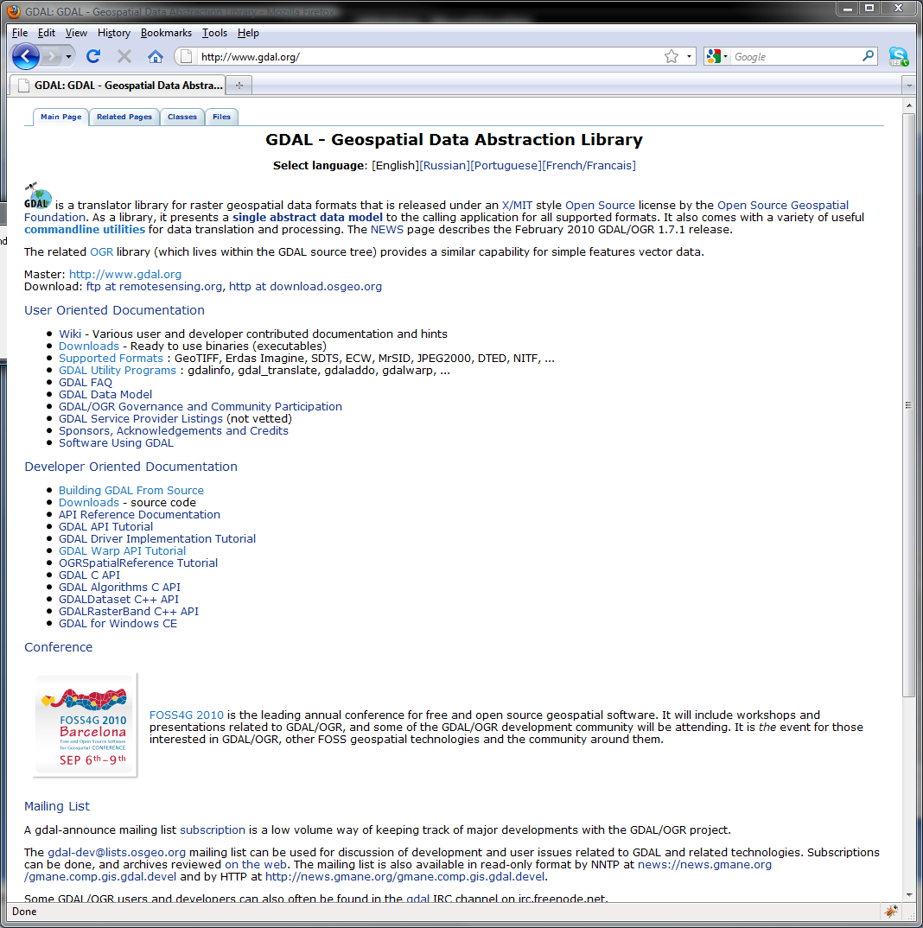
GDAL

